Slide 1
10 Things for Spring Cleaning
Todd Kaufman
Quick Solutions

Slide 2
Why Me?
Chris Judd
Joe O’Brien
Brian Sam-Bodden
Joe Nusairat
Following Neal Ford sucks
FANBOY!

Slide 3
Why Not Java EE?
Expensive
Complex
Untestable
Lethargic
Vendor driven

Slide 4
Why Spring?
No application server
Simplified
Testable
Agile
Pervasive

Slide 5


Fanboy

Slide 6

#1 - Scheduling
Courtesy of bcostin on flickr
Notes:
Courtesy of bcostin on flickr

Slide 7
Scheduling in Java
Can be
Invasive
External
Expensive
Spring provides
Pluggable implementations
Late additions
Separation of concerns

Slide 8
Scheduling in Spring
Quartz
Jobs and Triggers (Simple or Cron)
Suitable for complex scheduling
SchedulerFactoryBean
JDK Timer
Tasks
TimerFactoryBean
No namespace support yet
Spring JIRA – 4359
Sched Namespace JAR
Notes:
Timer - Provided by JDK since 1.3
Quartz can be database backed

Slide 9
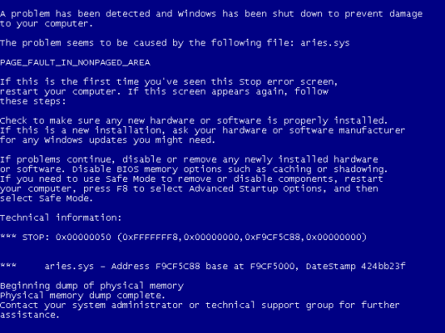
Demo

Slide 10

#2 - Web Services in 5 Steps
Courtesy of DCvision2006 on flickr
Notes:
Courtesy of DCvision2006 on flickr

Slide 11
Web Service Options
Typically
Disparate: JAX-RPC, JAX-WS, Xfire, Axis
Schema and Endpoint
With Spring WebServices
Still Disparate
Pluggable (APIs and Marshalling)
Contract First
Loosely Coupled

Slide 12
Steps to create a WS
Verbose instructions found here
Write the Schema
Create the Project with Maven
Implement the endpoint (Message or Payload)
Tweak the pom.xml for your dependencies (JDom, dom4j, StAX, etc…)
Application Context changes
Plug dependencies in for your Endpoint
Plug a mapping bean in for your service
Create the WSDL via bean definition

Slide 13
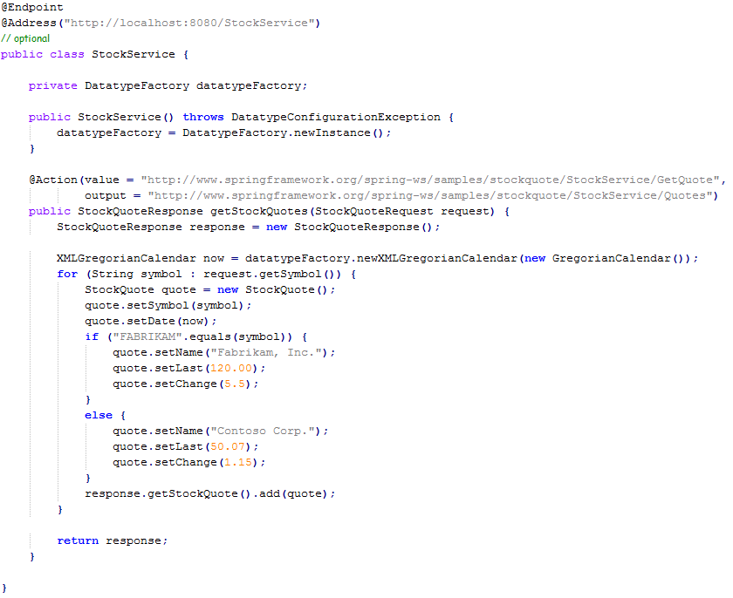
Code

Slide 14
Notes
Spring-WS now 1.5
WS-Addressing via annotations or configuration
Reuses your Spring expertise
Supports WS-Security
JDKs 1.4 -> 1.6 supported
Spring-WS jars are now OSGi bundles

Slide 15

#3 – Spring Integration
Courtesy of slack12 on flickr
Notes:
Courtesy of slack12 on flickr

Slide 16
Integration
Loosely coupled systems
Glued together with messages
Patterns available
Book by Gregor Hohpe and Bobby Wolfe
EIP Website
Vendor based solutions
Expensive
Proprietary
Complex
Notes:
Simplicity by hiding thread and queue management
Customization of routing, endpoints, channels and more
Decoupling business component from message infrastructure

Slide 17
Spring Integration
Spring Portfolio addition in Dec. 2007
Not fully baked (1.0 M3)
Simple messaging
Simple endpoints
Business logic != integration logic
Incremental adoption
ESB?

Slide 18
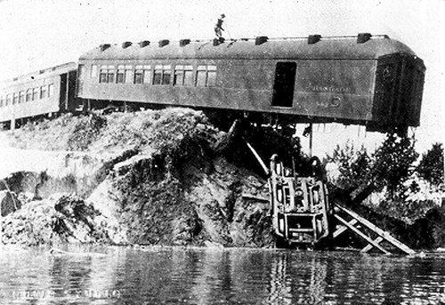
Integration Demo

Slide 19

#4 Web Testing
Courtesy of bunchofpants on flickr
Notes:
Courtesy of bunchofpants on flickr

Slide 20
Web App Testing
Complex
Tightly coupled
Too many choices
That’s what QC is for
Lazy
Notes:
Annotation driven controllers have no Request or Response objects so ModelMaps are the extent of it
AbstractModelAndViewTests and ModelAndViewAssert provide some simplified methods for testing MAV objects

Slide 21
Spring Helps
Spring MVC
No ActionForm
Controllers separate
Annotation based controllers need 0 mocks
AbstractModelAndViewTests
ModelAndViewAssert
Elsewhere
Easy to use and extensive Mocks

Slide 22
Mockity, Mock, Mock
MockHttpServletRequest
MockHttpServletResponse
MockHttpSession
DelegatingServletInputStream
DelegatingServletOutputStream
MockExpressionEvaluator
MockFilterConfig
MockPageContext
MockRequestDispatcher
MockServletConfig
Notes:
MockHttpServletRequest – You most likely will find a use for this class in every single one of your unit tests. It is the mock implementation of the most frequently used interface in J2EE Web applications: HttpServletRequest.
MockHttpServletResponse – Use this object for mock implementations of the HttpServletResponse interface.
MockHttpSession – This is another frequently used mock object. (This article will review use of this class for session-bound processing later.)
DelegatingServletInputStream – Use this object for mock implementation of the ServletInputStream interface.
DelegatingServletOutputStream – This object delegates the implementation of ServletOutputStream. It can be useful if you need to intercept and examine the content written to an output stream.
MockExpressionEvaluator – You use this mock object mostly when you intend to develop and test your own JSTL-based tag libraries.
MockFilterConfig – This is a mock implementation of the FilterConfig interface.
MockPageContext – This is a mock implementation of the JSP PageContext interface. You may find this object useful for testing pre-compiled JSPs.
MockRequestDispatcher – This is a mock implementation of the RequestDispatcher interface. You use it mostly within other mock objects.
MockServletConfig – This is a mock implementation of the ServletConfig interface. Unit testing some Web components, such as the ones the Struts framework supplies, requires you to set the ServletConfig and ServletContext interfaces implemented by MockServletContext.

Slide 23
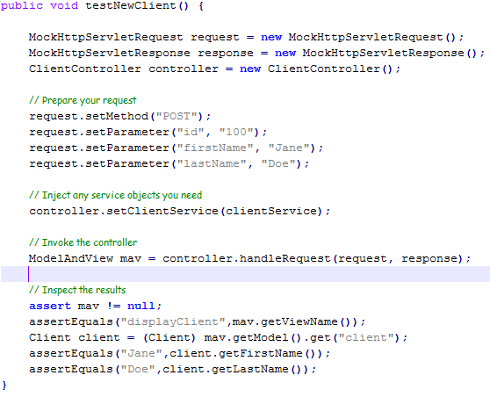

Slide 24

#5 – Simplified Security
Courtesy of William Couch on flickr
Notes:
Courtesy of William Couch on flickr

Slide 25
Spring Security 2.0
Formerly ACEGI
Released 4/2008
Now with less Fairy Death!
“Every time you use Acegi...A fairy dies.” - Daniel Deiphouse
Significant changes:
Simplified configuration
Hierarchical roles
Integration
Notes:
AppFuse's security.xml went from 175 lines to 33 with the new security namespace configuration!

Slide 26
Simplified Authentication
Everything under the sun supported
Transparent propagation
Anonymous
Run-as
Java Authentication and Authorization Service (JAAS)
Automatic "remember-me" authentication
Notes:
HTTP BASIC, HTTP Digest, X.509, LDAP, Form-based, OpenID, Computer Associates Siteminder, Central Authentication Service (CAS), etc…
Transparent propagation -> over RMFIF and HTTPInvoker
Anonymous -> All calls assume a single identity
Run-As -> One call proceeds with a different identity

Slide 27
Remember Me?
Automatic login (No JSESSIONID)
Default Implementation
Cookie
base64(username + ":" + expirationTime + ":" + md5Hex(username + ":" + expirationTime + ":" password + ":" + key))
ExpirationTime is configurable
As always, pluggable implementations supported

Slide 28
Authorization Simplified
XML based with new security namespace
JSP tag based
Annotation based with @Secured
Annotation based with the JSR-250 security annotations

Slide 29

Spring Security Demo
Courtesy of bennylin0724 on flickr
Courtesy of bennylin0724 on flickr
Notes:
Courtesy of bennylin0724 on flickr

Slide 30

#6 – Batch Processing
Courtesy of Brymo on flickr
Notes:
Courtesy of Brymo on flickr

Slide 31
Batch Processing
Not scheduling
Bulk processing
No user interaction
Concurrency
Restarts
Partial processing

Slide 32
Spring Batch
Business logic focused
Multiple format support
Automatic retry
Job statistics
Logging/Tracing
Job management
Transaction management

Slide 33
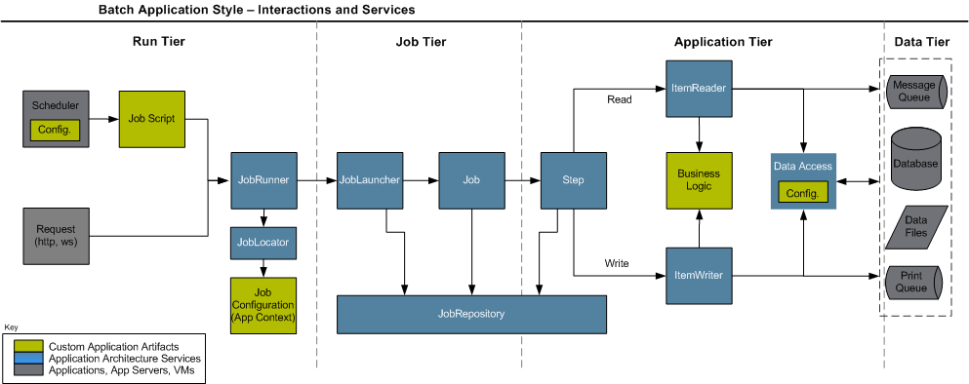
Batch Processing at 10,000ft
Notes:
Run Tier: The Run Tier is concerned with the scheduling and launching of the application. A vendor product is typically used in this tier to allow time-based and interdependent scheduling of batch jobs as well as providing parallel processing capabilities.
Job Tier: The Job Tier is responsible for the overall execution of a batch job. It sequentially executes batch steps, ensuring that all steps are in the correct state and all appropriate policies are enforced.
Application Tier: The Application Tier contains components required to execute the program. It contains specific tasklets that address the required batch functionality and enforces policies around a tasklet execution (e.g., commit intervals, capture of statistics, etc.)
Data Tier: The Data Tier provides the integration with the physical data sources that might include databases, files, or queues.
Green – Developer, Blue – Spring, Grey - Vendor

Slide 34

#7 - Cache
Courtesy of Bashed on flickr
Notes:
Courtesy of Bashed on flickr

Slide 35
When to Cache?
When services are
Expensive
Remote
Predictable
Not real time data
Read mostly
Not clustered

Slide 36
Caching with Spring
Part of the Spring Modules Project
Allows 4th quarter Caching
Wraps your POJO
Pluggable Providers
EHCache, JBoss Cache, Java Caching System (JCS), OSCache, and Tangosol Coherence.

Slide 37
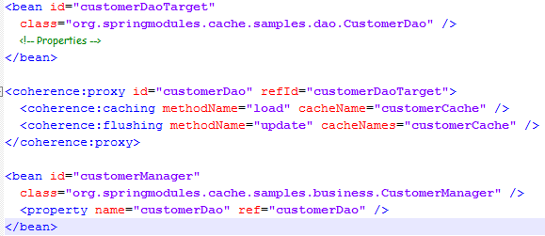
Angle Bracket Caching

Slide 38
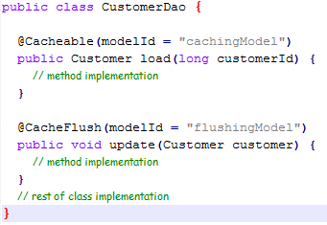
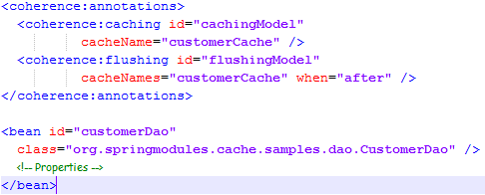
Annotation Driven Caching

Slide 39
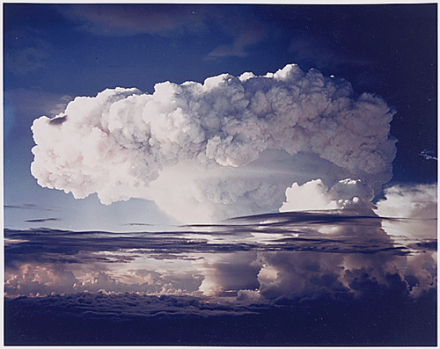
#8 – Transactional Testing

Slide 40
Testing with Transactions
Integration tests are mandatory
Magic numbers kill kittens
Data setup and teardown can be brutal
Isolation is difficult
Notes:
Operation Ivy Nuclear Test

Slide 41
Spring Test Fixtures
Classes Provided
AbstractTransactionalTestNGSpringContextTests
AbstractTransactionalJUnit4SpringContextTests
AbstractTransactionalJUnit38SpringContextTests
Annotations Provided
@Before/After inside Tx
@BeforeTransaction/AfterTransacton outside Tx

Slide 42

TestNG Transaction Demo
Courtesy of jaybowalkin on flickr
Notes:
Courtesy of jaybowalkin on flickr

Slide 43

#9 - Logging and Profiling
Courtesy of herby_fr on flickr

Slide 44
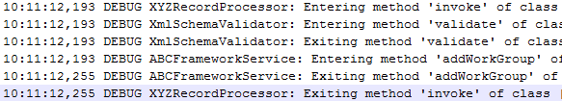
A Common Occurrence
Ever see this?

Slide 45
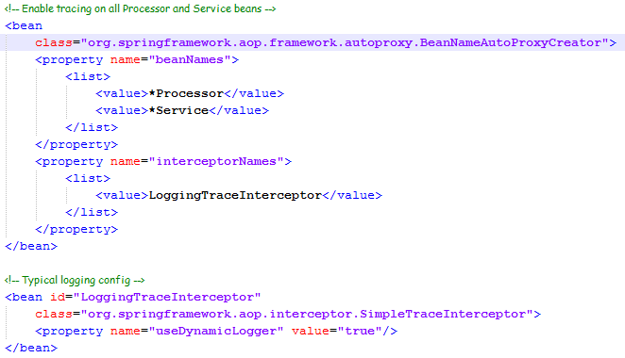
Configuration is Simple

Slide 46
Profiling with JAMon
Experiencing performance issues?
Questioning application usage?
Unable to use a profiler?
JAMon to the rescue!
Timing data: total, average, minimum, maximum, standard deviation
JDBC/SQL, HTTP, and EJB3 monitoring built in
Web or log file based views

Slide 47
JAMon with Spring
JamonPerformanceMonitorInterceptor
Introduced in Spring 1.1.3
Can be enabled with TRACE in log4net
Set trackAllInvocations = true to avoid this
BeanNameAutoProxyCreator
Surgically Injected via AOP

Slide 48
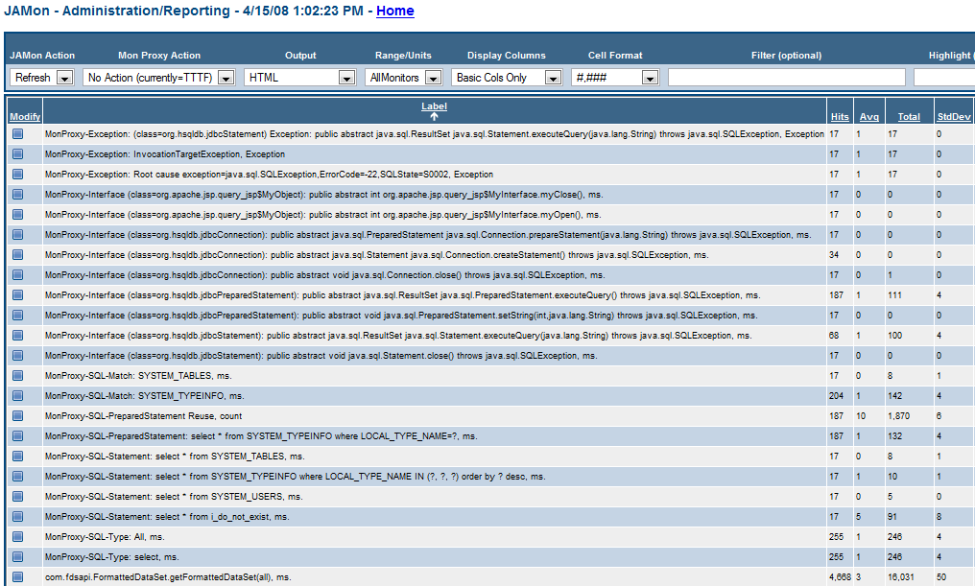

Slide 49

#10 – Dynamic Language Beans
Courtesy of feastoffools on flickr
Notes:
Courtesy of feastoffools on flickr

Slide 50
Why Dynamic Languages in Java
Rules Light
Navigation Complexity
Better Mocks
Incremental Adoption
Dynamic Components

Slide 51
DL Support in Spring
Introduced in Spring 2.0
Supports JRuby (1.0), Groovy, and BeanShell
AOP Needs Interfaces
Refreshable and Self Monitoring

Slide 52

JRuby Integration Demo
Courtesy of Arnisto.com on flickr
Notes:
Courtesy of Arnisto.com on flickr

Slide 53
???
tkaufman@quicksolutions.com
Work: 614-896-2031
Gtalk: toddkaufman
MSN: todd.kaufman@live.com
AIM: tkauf5000
PSN: tkaufman
Twitter: toddkaufman
Blog: toddkaufman.blogspot.com

